Slide 1
PROPERTY LISTING ANALYSIS FOR PROPERTY RENTAL COMPANY
SQL PROJECT
By: Jaymin Parekh (Code:289)
Sachin Gupta (Code:339)

Slide 2
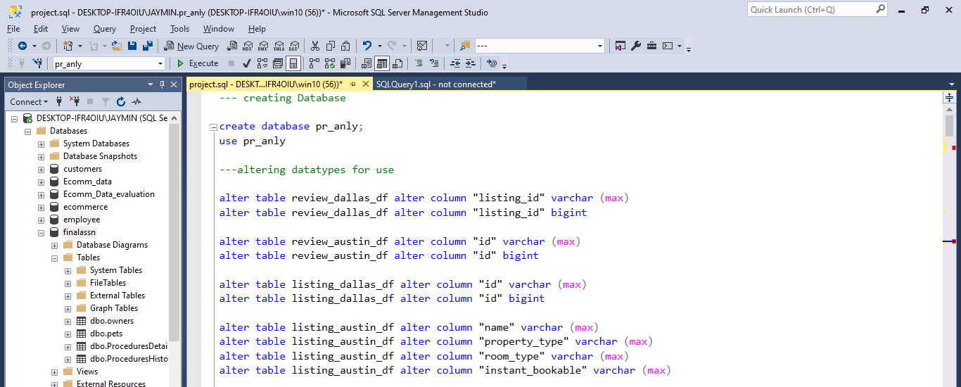
Beginning with creating DB and altering fields

Slide 3
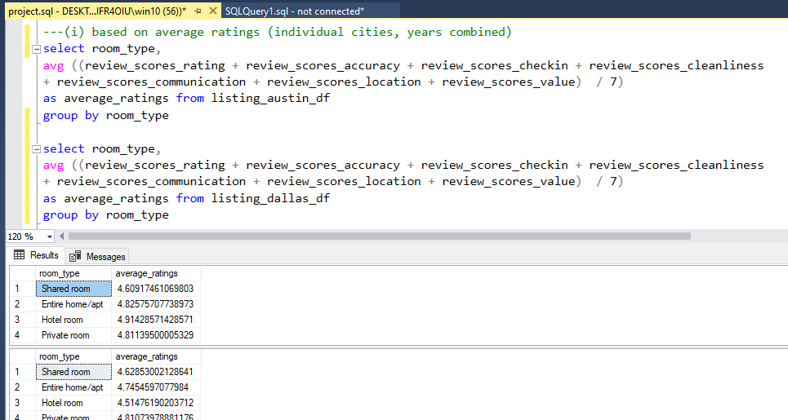
Analyze different metrics to draw the distinction between the different types of
property along with their price listings(bucketize them within 3-4 categories basis
your understanding): To achieve this, you can use the following metrics and explore a few yourself
as well.
Ans) Showing SQL Query And Excel Charts

Slide 4
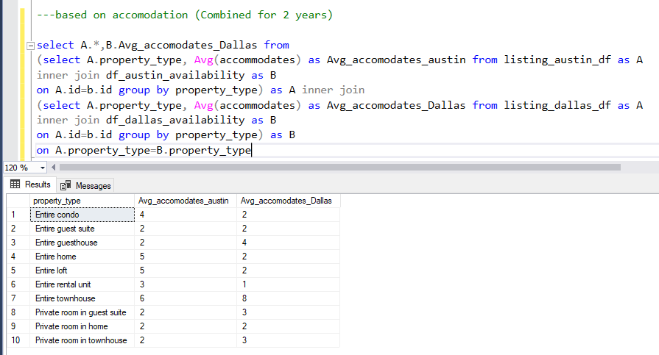

Slide 5
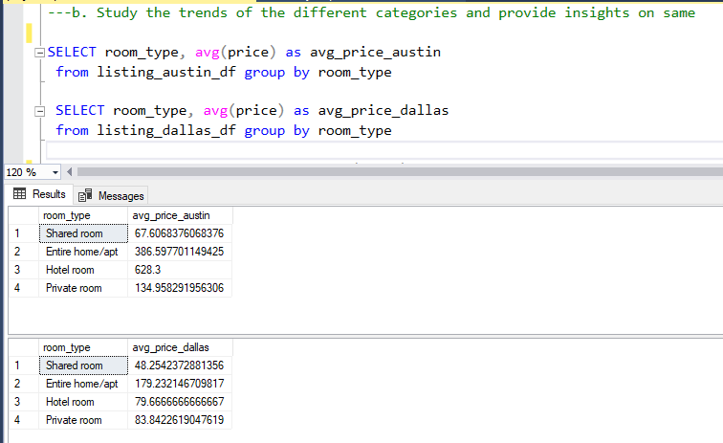
b. Study the trends of the different categories and provide insights on same

Slide 6
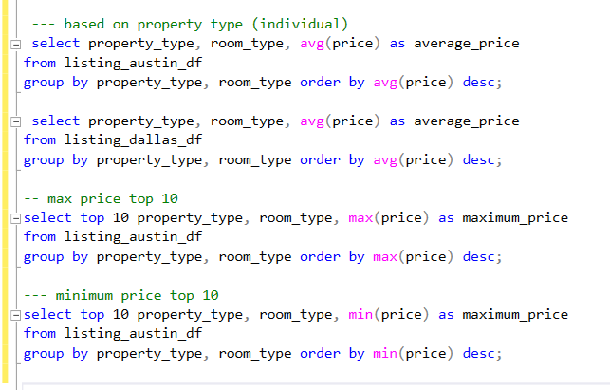

Slide 7
c. Using the above analysis, identify top 2 crucial metrics which makes different
property types along their listing price that stand ahead of other categories
Ans-
Average Number of Bookings
It signifies that how many repetitive times a particular property is being booked on a particular length of time.
If the number is high it signifies better facilities with proper value, prime location, good services etc. which implies a direct relation with the price of a property.
Availability
It can be also called as the Acceptance rate which represents the share of occupied property during a certain time period. This Directly affects the demand of the property and price of the property.

Slide 8
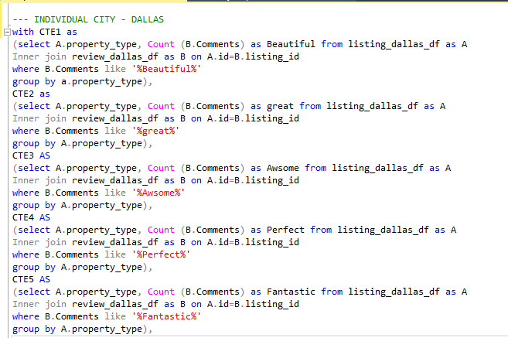
d. Analyze how does the comments of reviewers vary for listings of distinct categories
(Extract words from the comments provided by the reviewers) Ans) Both Cities analysed individually
Continued…

Slide 9

Continued…

Slide 10
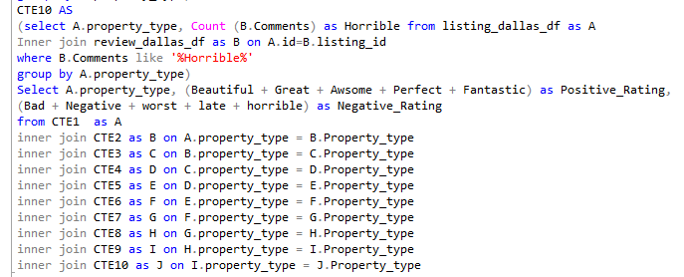

Slide 11
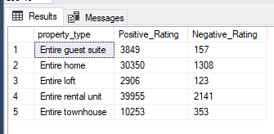
Output with visualisation

Slide 12
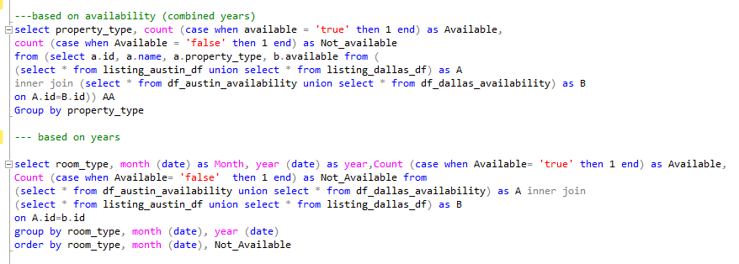
e. Analyze if there is any correlation between property type and their availability across the months
Ans ) I have used correlation between property type availability, room type and monthly availability

Slide 13
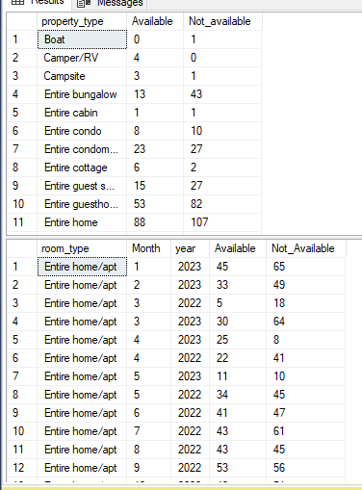
Output with visualisation

Slide 14


Slide 15

f. Analyze what are the peak and off-peak time for the different categories of property type
and their listings. Do we see some commonalities in the trend or is it dependent on the
category

Slide 16
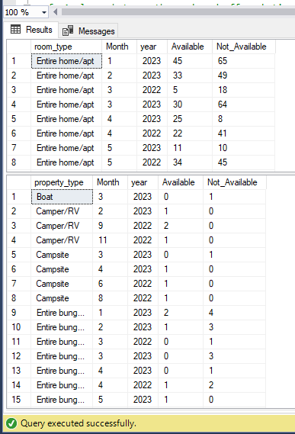
Output:

Slide 17
g. Using the above analysis, suggest what is the best performing category for the company
Following analysis were observed:
Combining both the countries, Entire Home / Appartment are most demanded
in room category
Entire building is the most booked property, also it is most pre-booked for upcoming year
(2023)
In Austin Hotel Rooms are most expensive and in Dallas Entire Home are most expensive

Slide 18
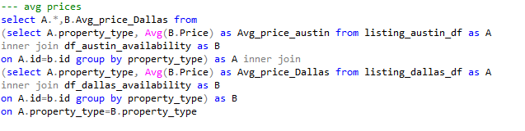
h. Analyze the above trends for the two cities for which data has been provided and provide insights on comparison
Ans) For Avg prices

Slide 19
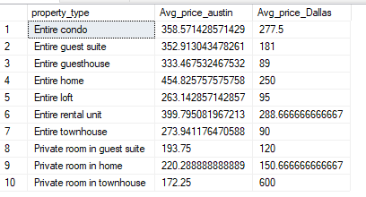
Output with visualisation

Slide 20
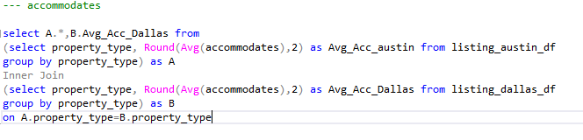
Accomodations

Slide 21
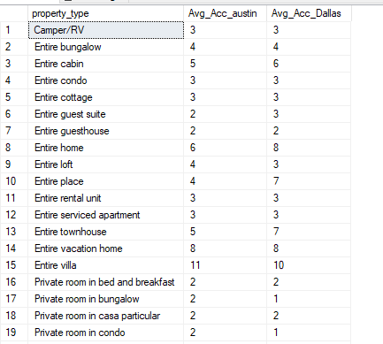
Output with visualisation

